Slide 1
Pipelined Parallel AC-based Approach for Multi-String Matching
Authors: Wei Lin, Bin Liu
Publisher: ICPADS, 2008
(IEEE International Conference on Parallel and Distributed Systems)
Presenter: Chia-Yi, Chu
Date: 2014/03/05

Slide 2
Outline
Introduction
Related works
P2-AC algorithm and architecture
Performance evaluation

Slide 3
Introduction (1/3)
A pipelined parallel approach for hardware implementation of Aho-Corasick (AC) algorithm for multiple strings matching called P2-AC is presented.
simplifies the DFA state transition graph into a character tree that only contains forwarding edges.
The memory cost is less than 47% of the best known AC-based methods.
supports incremental update and scales well with the increasing number of strings.

Slide 4
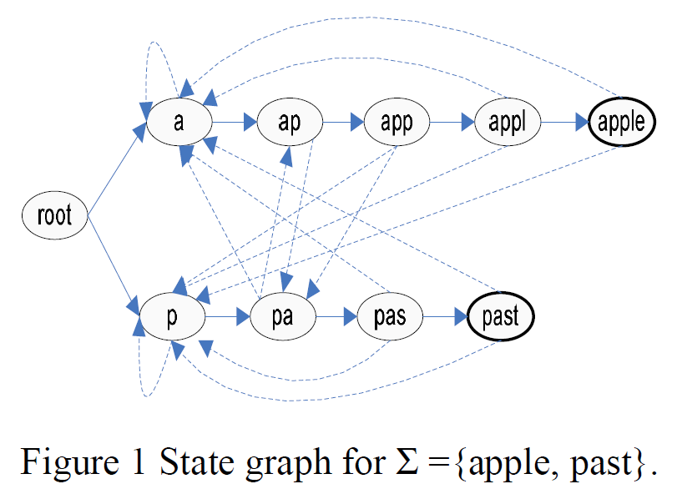
Introduction (2/3)
An entry in the transition rule table is a 3-tuple
E= (u=current state, i=input symbol, v=next state).
Forward edge:
if the level number of v is equal to 1 plus the level number of u.
Cross edges:
remaining edges

Slide 5
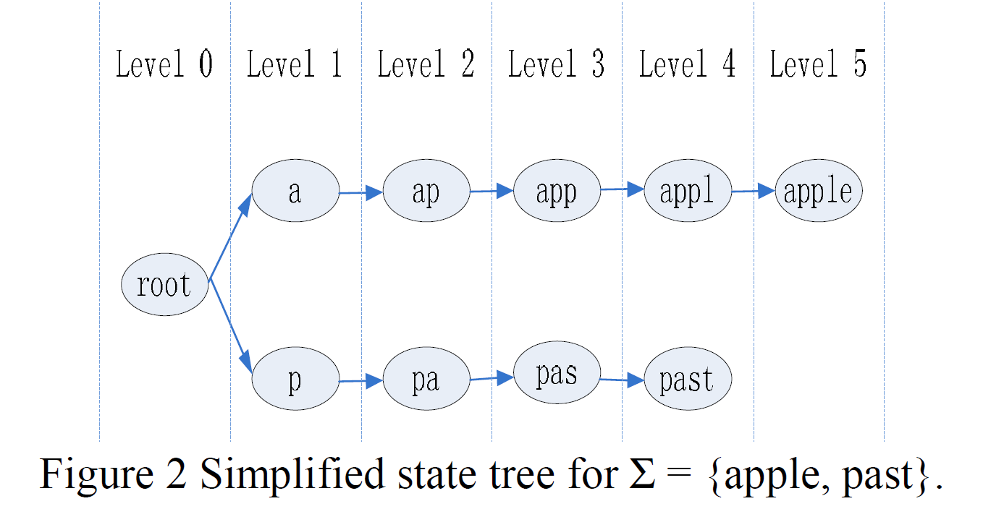
Introduction (3/3)
All cross edges can be eliminated from the state graph, which is simplified to a character tree.

Slide 6
P2-AC algorithm and architecture (1/)
In order to reduce the number of states in DFA state graph, all patterns and input characters are converted to lower case.
For case sensitive pattern, a bitmap is used to specify each character of the pattern is lower or upper case.

Slide 7
P2-AC algorithm and architecture (2/)
The maximum number of threads to a constant value K
patterns longer than K are divided into multiple segments of length K except the last segment whose length is equal to or less than K.

Slide 8
P2-AC algorithm and architecture (3/)
The pattern matching system is composed of
Pipeline Unit (PU)
uses at most K threads to match each segment
Transition rules are stored separately in tables from LT1 to LT4.
The active current state is maintained by each stage.
Aggregation Unit (AU)
uses the matching result from the first part to aggregate the partial matched segments together to match the whole pattern.
Transition rules are stored separately in tables from T1 to T4.
Tstart is in T4 and stores the first segment for each long pattern.
State register Bi maintains each table’s active current state.

Slide 9
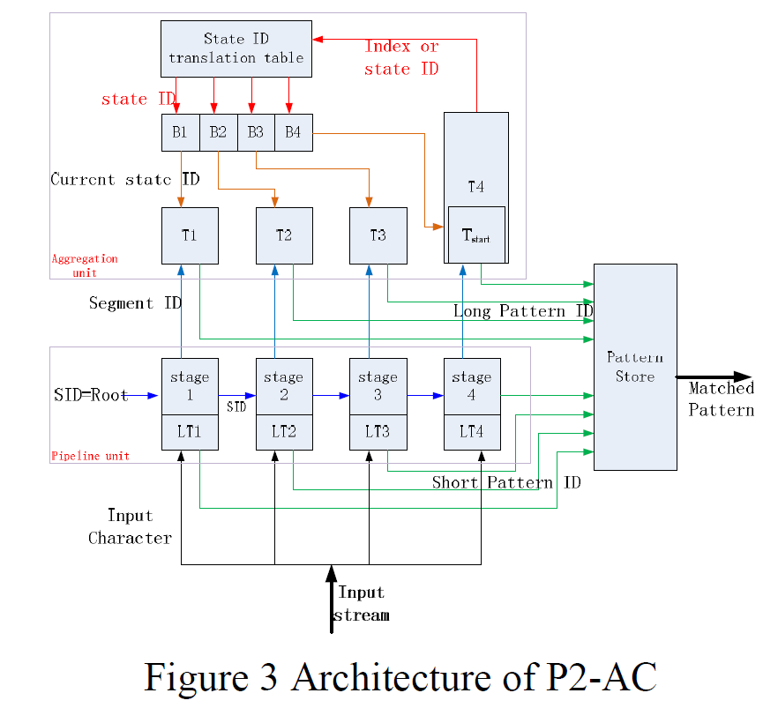
P2-AC algorithm and architecture (/)

Slide 10
P2-AC algorithm and architecture (4/)
Transition rules with the same current state are stored at the same address in multiple SRAMs.
The number of SRAMs in one stage is determined by the maximum number of transition rules with the same current state, which is called maximum fan-out number in this paper.

Slide 11
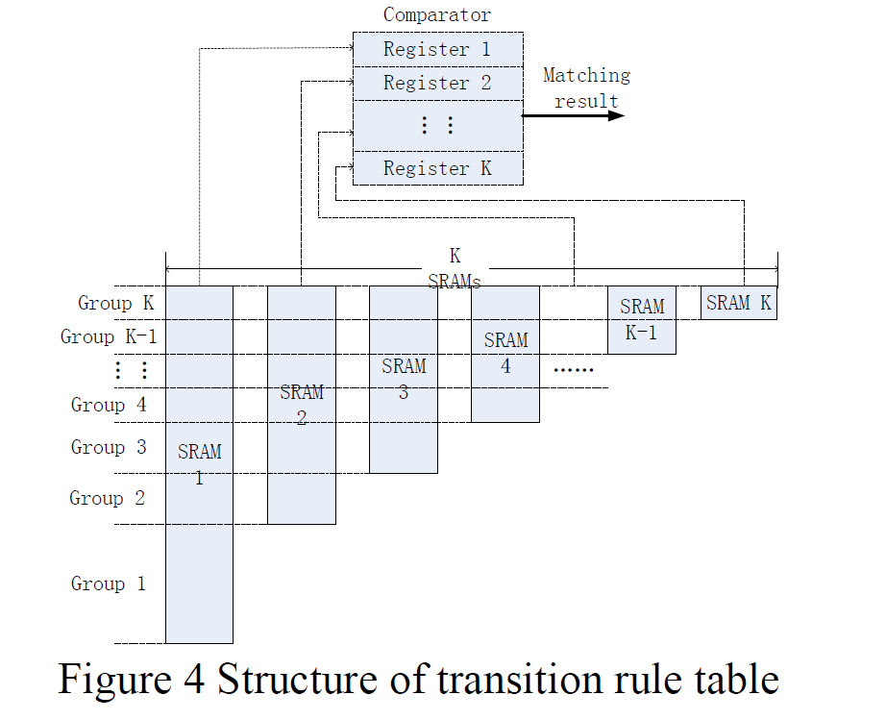
P2-AC algorithm and architecture (5/)

Slide 12
P2-AC algorithm and architecture (6/)
Because all the transition rules in LT1 have the same current state <root>, they are all stored in one SRAM which has 256 entries.
Transition rule use the ASCII code of the input Character as its address in the SRAM.
When looking up LT1, the input character will be used as index to locate the related transition rule in the SRAM.

Slide 13
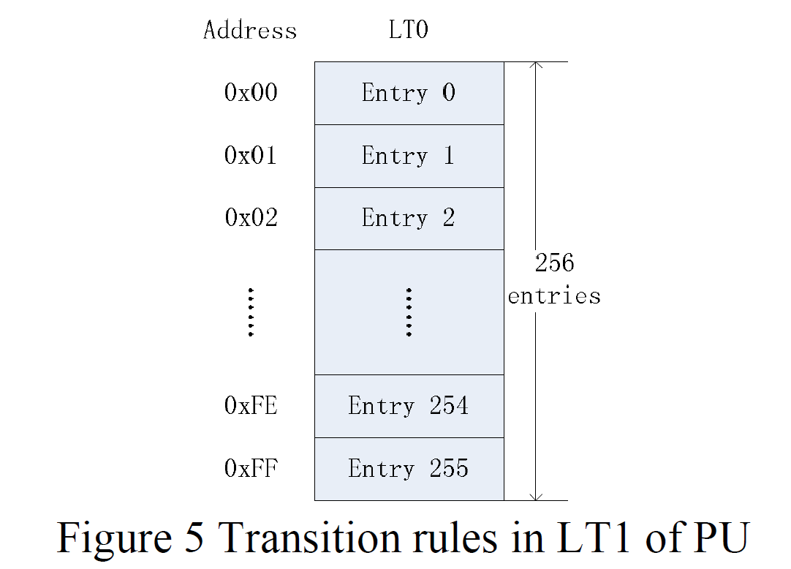
P2-AC algorithm and architecture (7/)

Slide 14
P2-AC algorithm and architecture (8/)
State ID Translation Table (STT)
Active current state for each table is maintained in current state registers, which are updated by STT each cycle.
STT is used to record the transition rules’ addresses for an active state in tables T1~T4.
The index of the active state is provided by T4.
An active state only exists in one table, it will not be stored in STT but directly provided by T4.

Slide 15
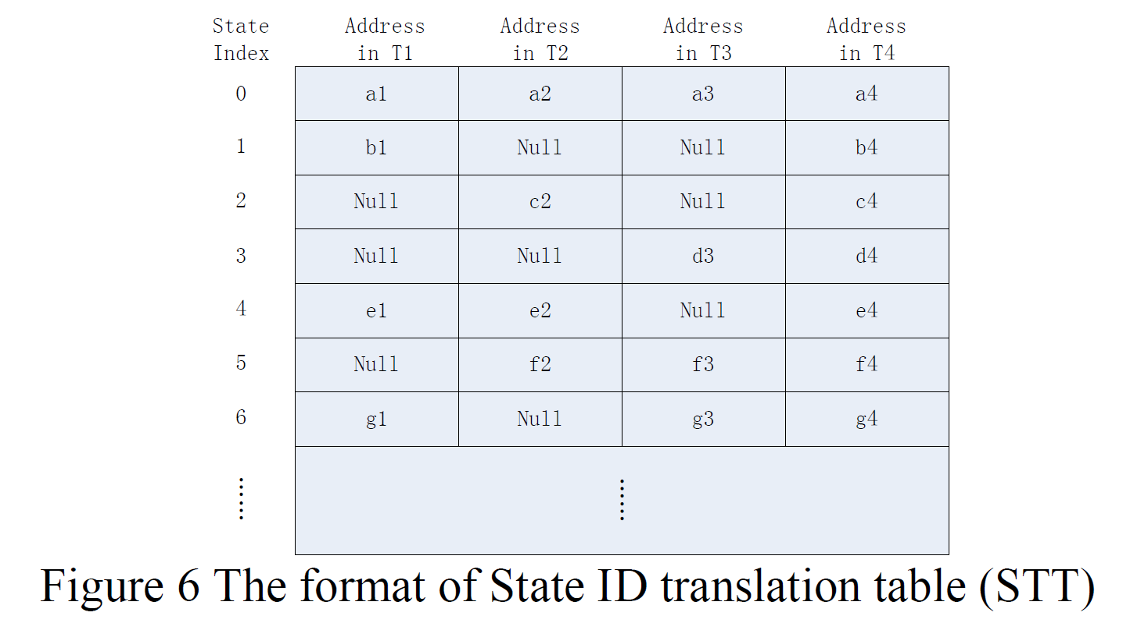
P2-AC algorithm and architecture (9/)

Slide 16
P2-AC algorithm and architecture (10/)
Example
The pattern set is {apple, applause, ampliation, past, pat, parable}
The input stream is “appampliation”.
The patterns are divided into 10 segments when K=4.
{pat, past} are patterns shorter than 4, which can be directly matched.
{appl, e, ause, ampl, iati, on, para, ble} are segments, which will be sent to AU for aggregation.

Slide 17
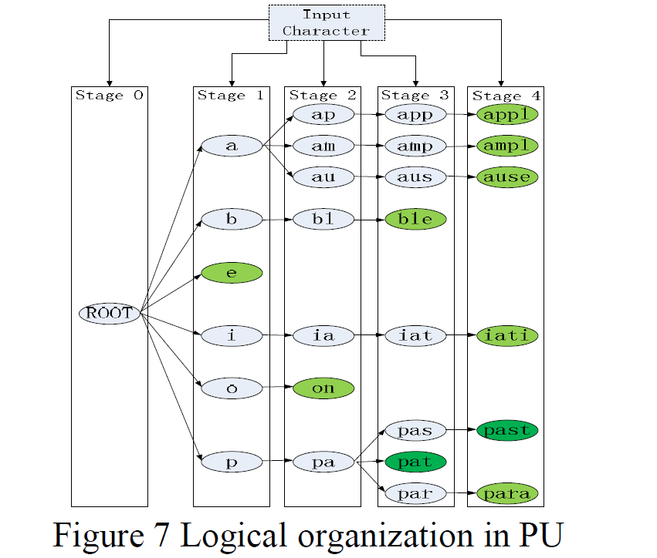
P2-AC algorithm and architecture (11/)

Slide 18
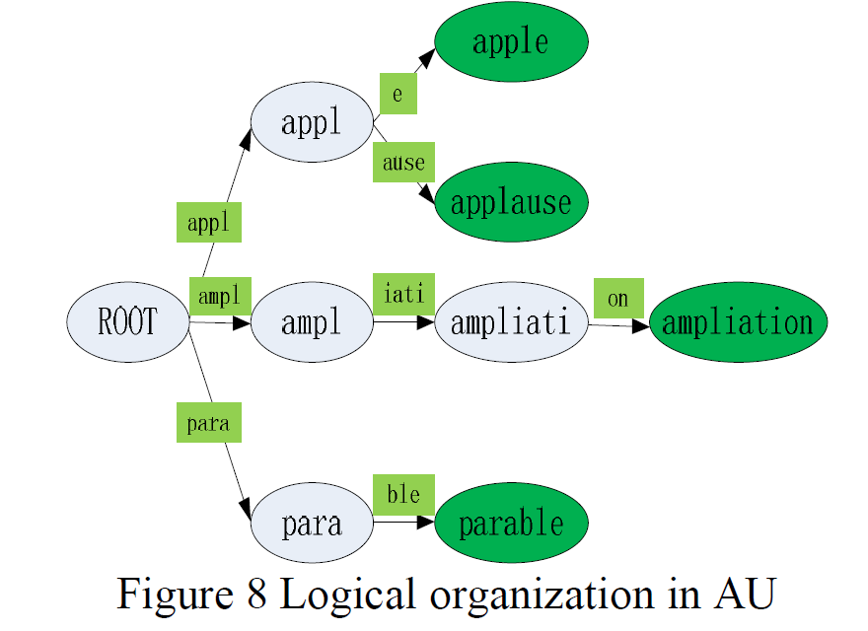
P2-AC algorithm and architecture (12/)

Slide 19
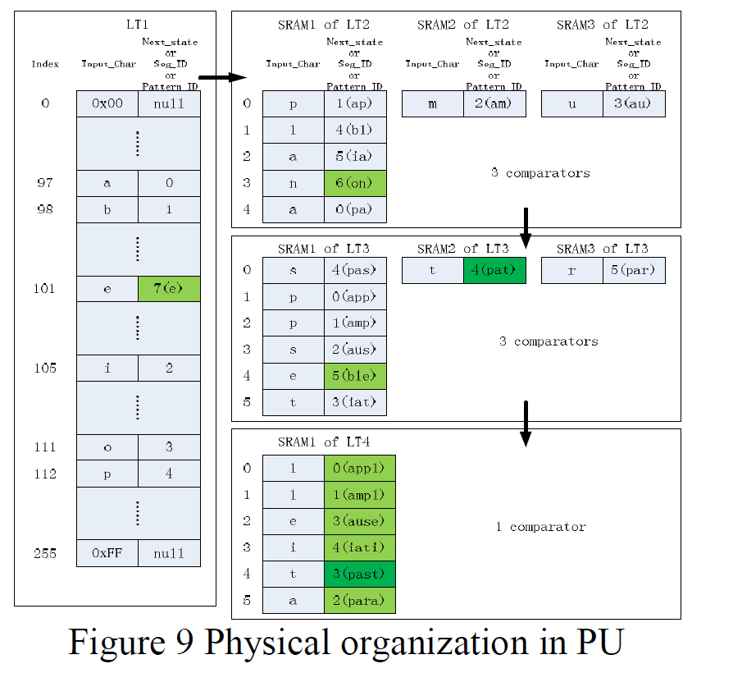
P2-AC algorithm and architecture (13/)

Slide 20
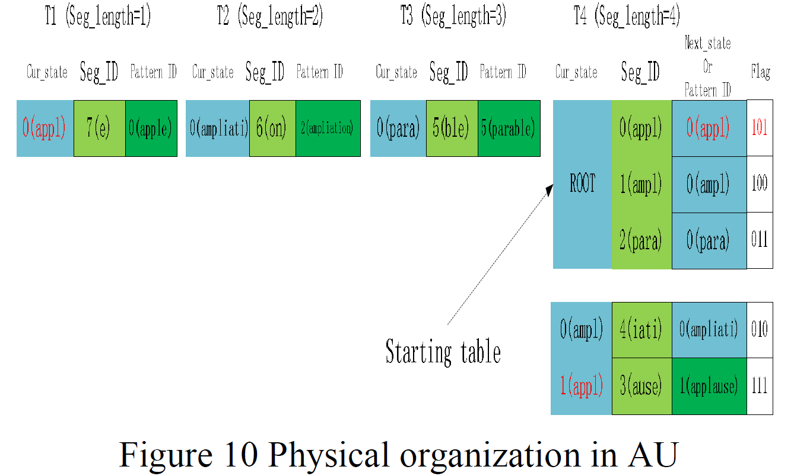
P2-AC algorithm and architecture (14/)

Slide 21
Performance evaluation (1/)
Altera’s Stratix II EP2S60 FPGA
Pattern set
Extract 5669 distinct patterns from the Snort V2.8 rule set
The signatures are converted into lower case letters
The total character count is 79211.
The maximum pattern length is 109 characters
The average length is about 14 characters.
About 96% of the signatures have no more than 36 characters.

Slide 22
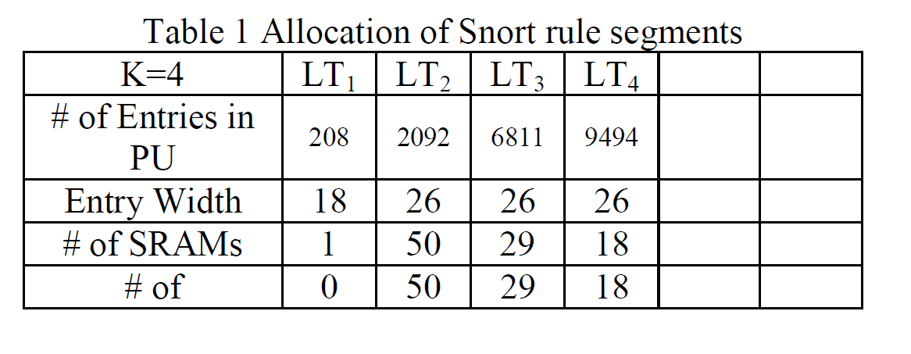
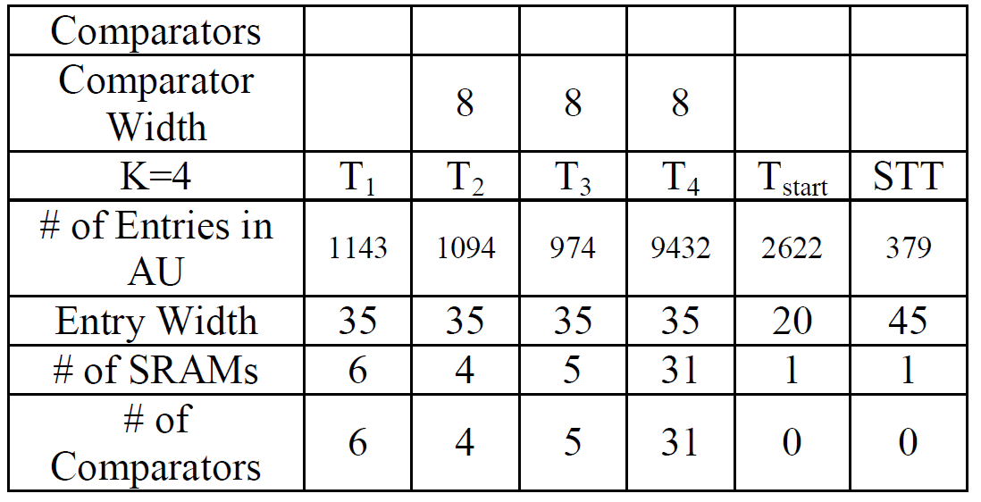
Performance evaluation (2/)

Slide 23
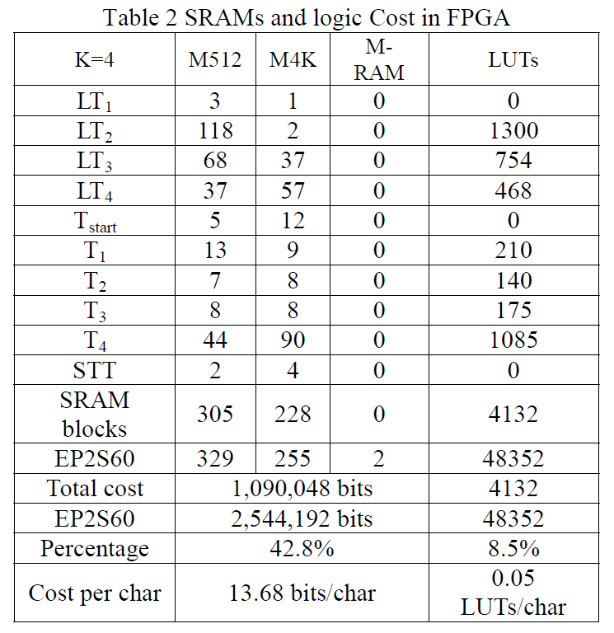
Performance evaluation (3/)

Slide 24
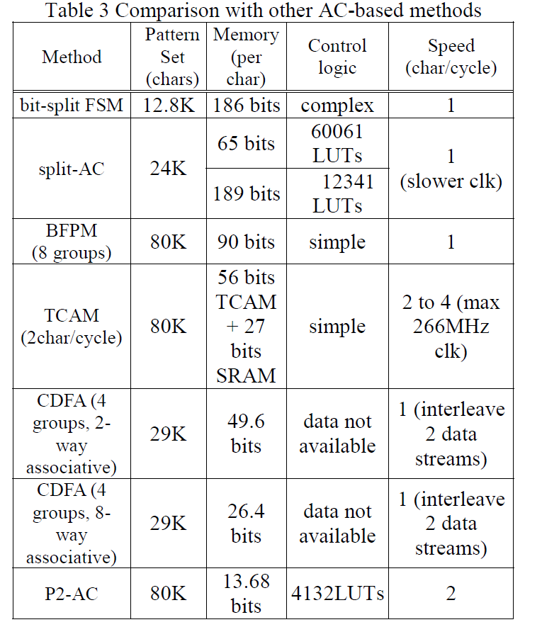
Performance evaluation (4/)

